Slide 1
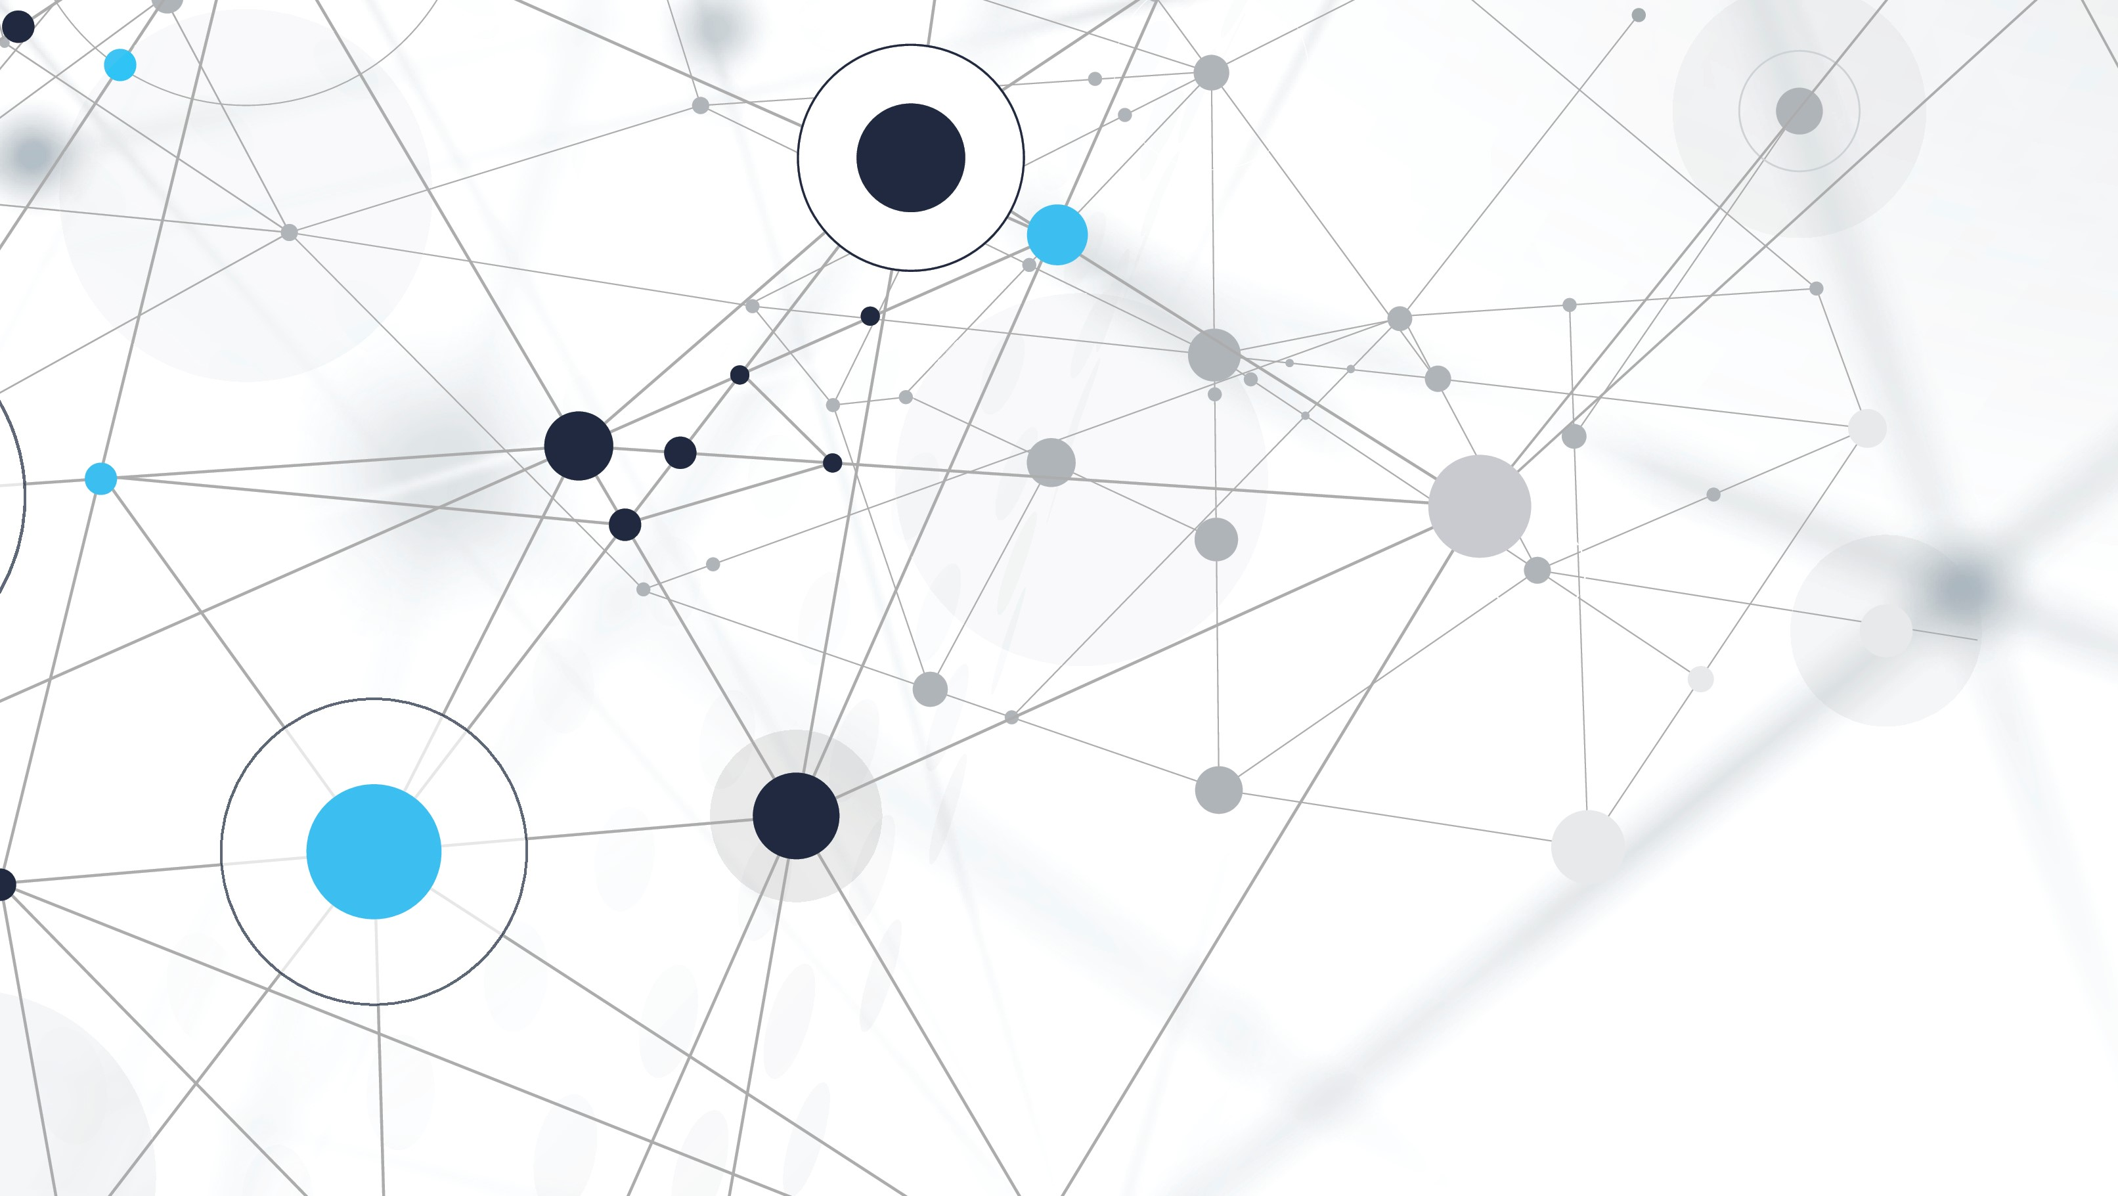
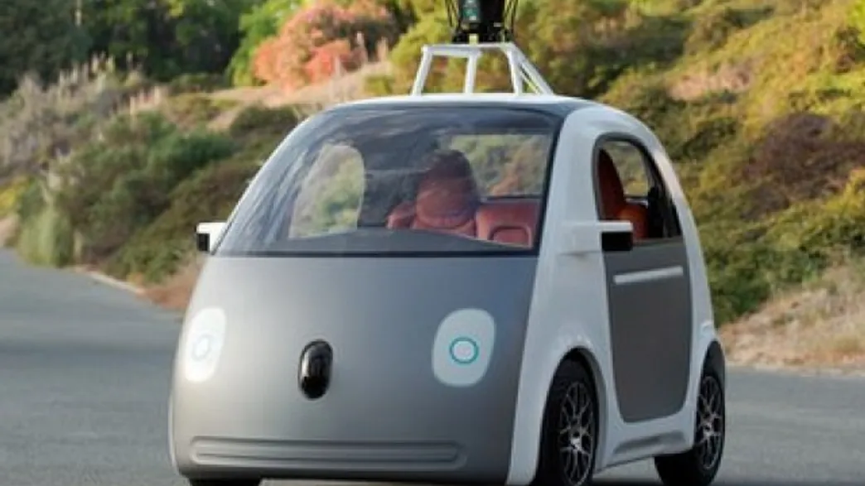
Google Autonomous Car: AI and Machine learning models
Willem Weidner

Slide 2
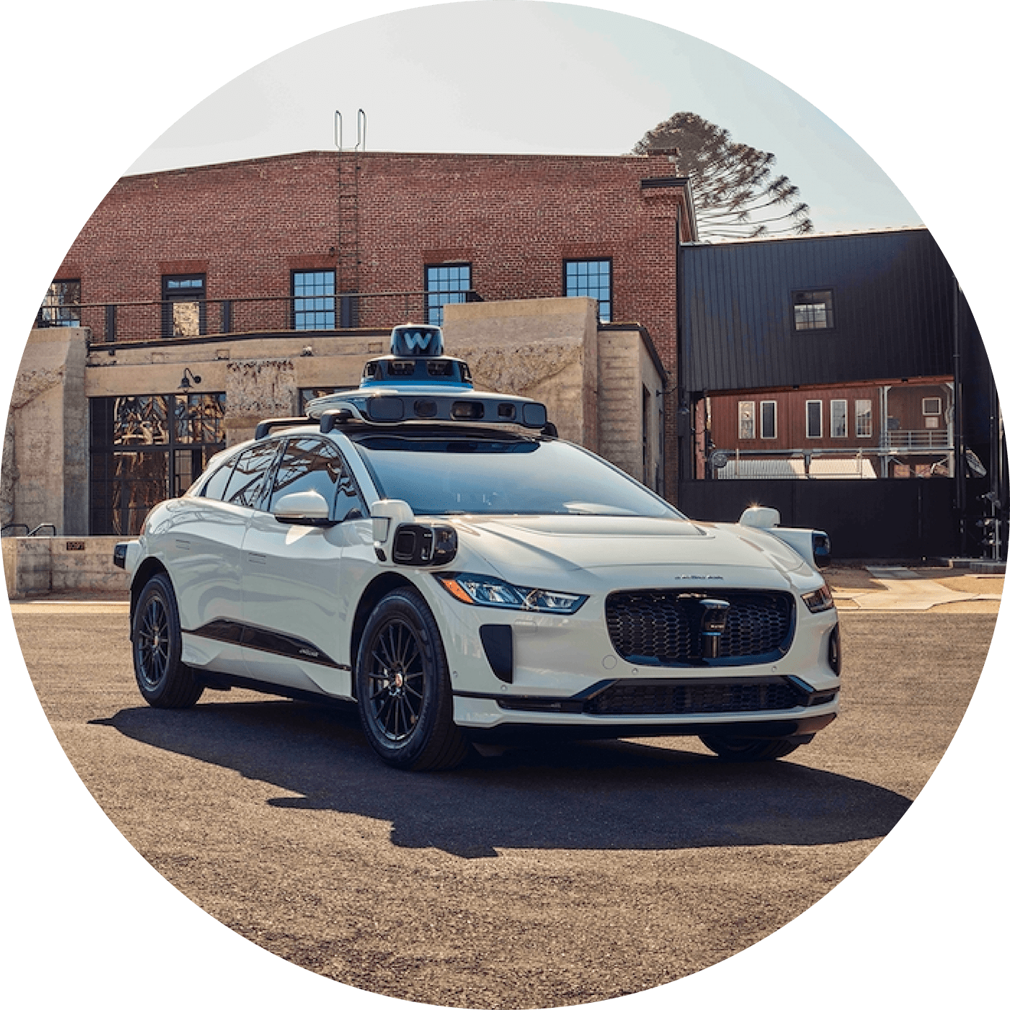
Why is this relevant?
reduced road accidents
improved traffic flow
increased personal time
expanded mobility

Slide 3
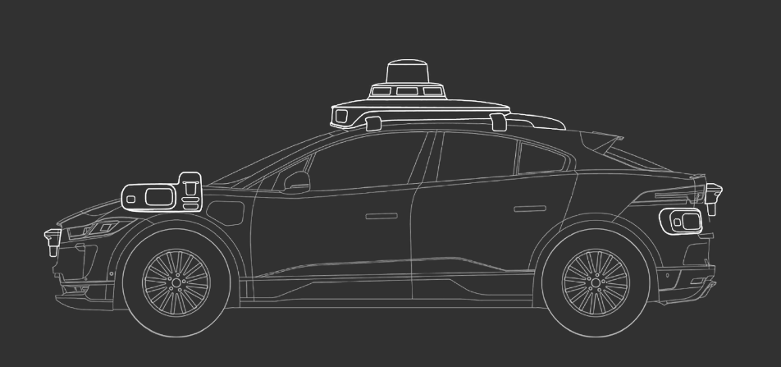
Machine Learning and AI in Waymo's Self-Driving Cars
Perception
Prediction
Planning
Control

Slide 4
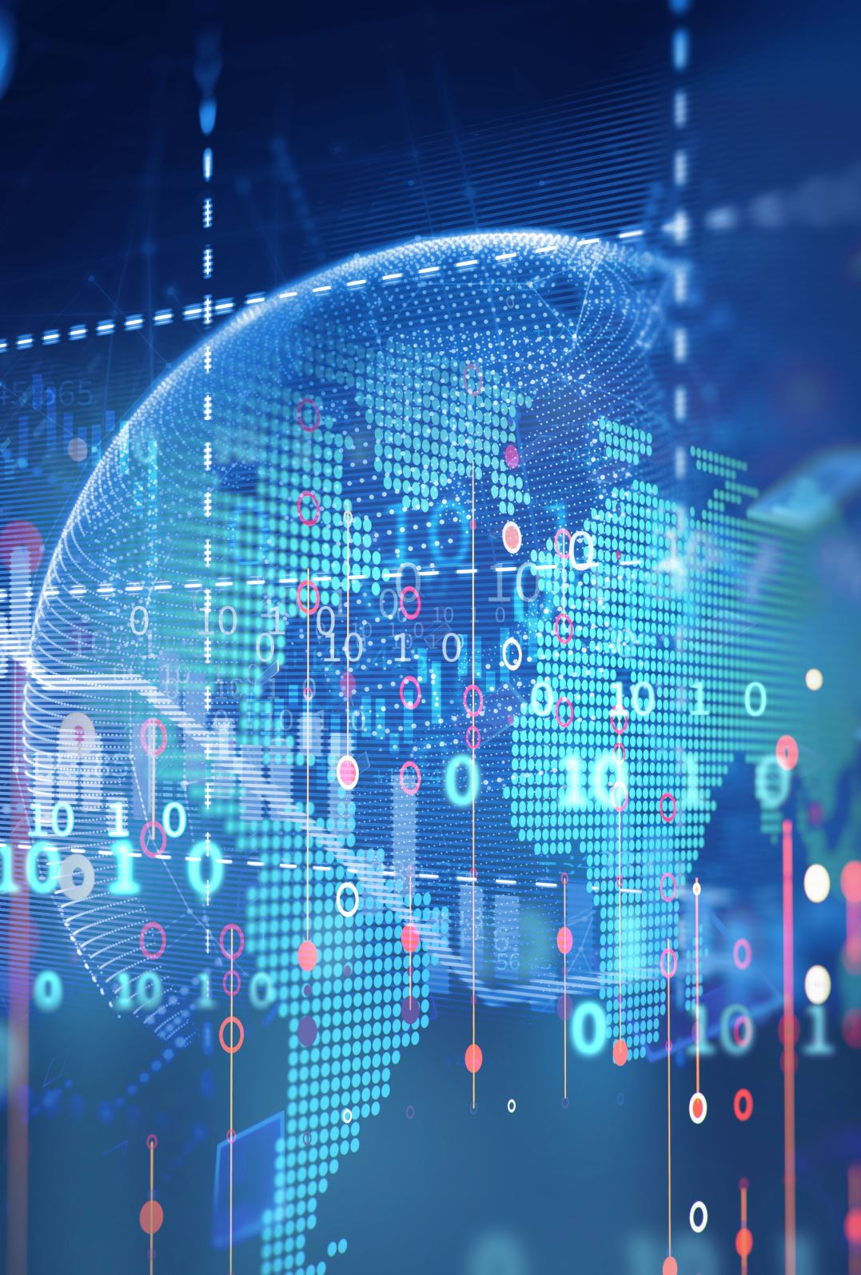
Data Collection and Model Training
20+ million miles of real world driving
20+ billion miles in simulation
GPS coordinates
Detailed maps of environment
Machine learning models
Sensor fusion
Object detection
Path Planning
Behaviour Prediction

Slide 5
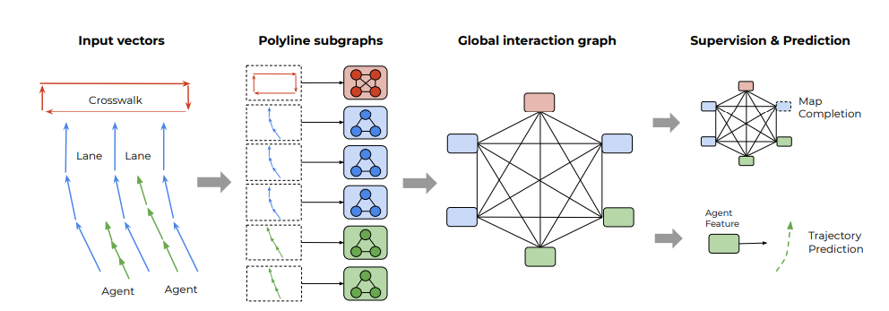
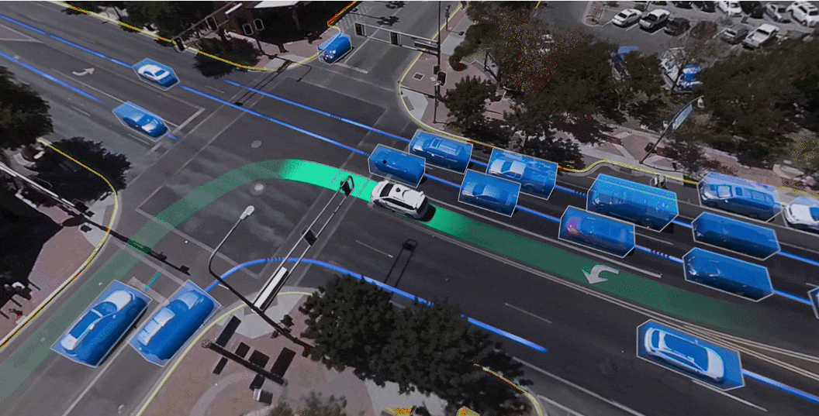
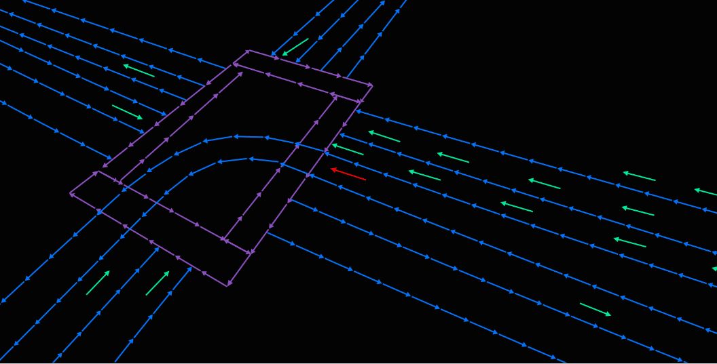
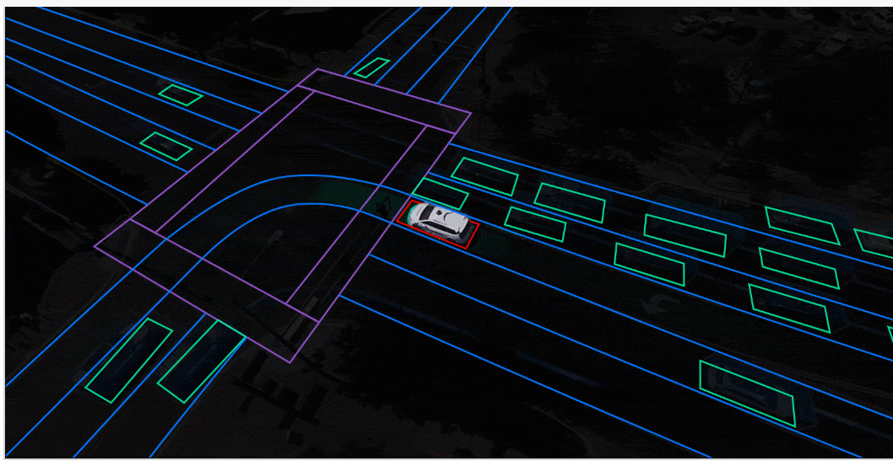
neural network for behaviour prediction (Vector Net)

Slide 6

Ethical Considerations and Collateral Effects
Liability
Job Displacement
Data Privacy

Slide 7
Related Projects
Aurora: A startup founded by former Google and Uber employees developed the Aurora Driver
Apple: reportedly developing its own self-driving car technology

Slide 8
Conclusion
Safer, more efficient, and more accessible transportation
Ethical concerns, liability, data privacy

Slide 9
Sources
https://www.iflscience.com/google-has-developed-self-driving-car-24607
https://waymo.com/waymo-driver/
https://waymo.com/blog/2021/10/the-waymo-driver-handbook-perception.html
https://waymo.com/blog/2021/08/MostExperiencedUrbanDriver.html
https://waymo.com/blog/2020/05/vectornet.html
https://arxiv.org/abs/2005.04259

